Slide 1

Department of Computer Science Gujarat University
5 Year Integrated M.Sc.(Computer Science)
Semester - VII
SZhoes Shopping Store
Presented By:
Ansh Yadav (36)
Under the Guidance of :
Dr. Bhumika Shah

Slide 2
Index
Sr. No | Title | Page No.
1. | Project Profile................................................................................ | 3
2. | Phase - 1 AI assistant..................................................................... | 4
3. | Project Description............................................................. | 5
4. | System Analysis................................................................... | 12
5. | Screenshots........................................................................ | 15
6. | Phase - 2 Website.......................................................................... | 16
7. | Project Description............................................................. | 17
8. | System Analysis.................................................................. | 20
9. | Class Diagram..................................................................... | 31
10. | Screenshots........................................................................ | 33

Slide 3
Project Profile
TITLE | DESCRIPTION
Project Title | SZhoes Shopping Store
Aim of the Project ( Phase - 1 ) | Create a AI Assistant who can handle query efficiently and retrieve solution for the query
Aim of the Project ( Phase - 2) | Develop an e-commerce website to sell a diverse range of high-quality footwear, seamlessly integrating with an ERP system.
Project duration | 6 month
Team size | 1 Member
Tools used | Visual Studio code, Git hub
Technologies used ( Phase - 1 ) | NLTK, Flask
Technologies used ( Phase - 2 ) | Next.js, Spring Boot, Flask, MongoDB, Tailwindcss
Guide | Dr. Bhumika shah

Slide 4
PHASE - 1
AI Assistant

Slide 5
Project Description
This project aims to develop a web-based FAQ search application that offers an intuitive and intelligent search experience using semantic search capabilities powered by a Vector Database (e.g. Pinecone)
The core innovation lies in retrieving contextually relevant answers to user queries by leveraging dot product similarity on pre-computed vector embeddings of FAQ data.
It provide the functionality like:
Semantic Search Engine
Dot Product Similarity
Real-Time Performance
Dynamic Results Display

Slide 6
AI assistant for FAQ
This project focuses on creating a web-based FAQ search application leveraging a Vector Database with semantic search capabilities. The core functionality employs dot product similarity searching to retrieve contextually relevant answers from a pre-processed FAQ dataset.
Dot product is a mathematical operation that determines similarity between vectors by measuring their directional alignment. It has certain advantages in terms of speed, scalability, and computational simplicity, especially for semantic search tasks using vector embeddings.
The application allows users to input questions, and the system retrieves the most semantically similar answer pairs from a vector database (eg. Pinecone). This provides a fast, intuitive, and context-aware search experience.

Slide 7
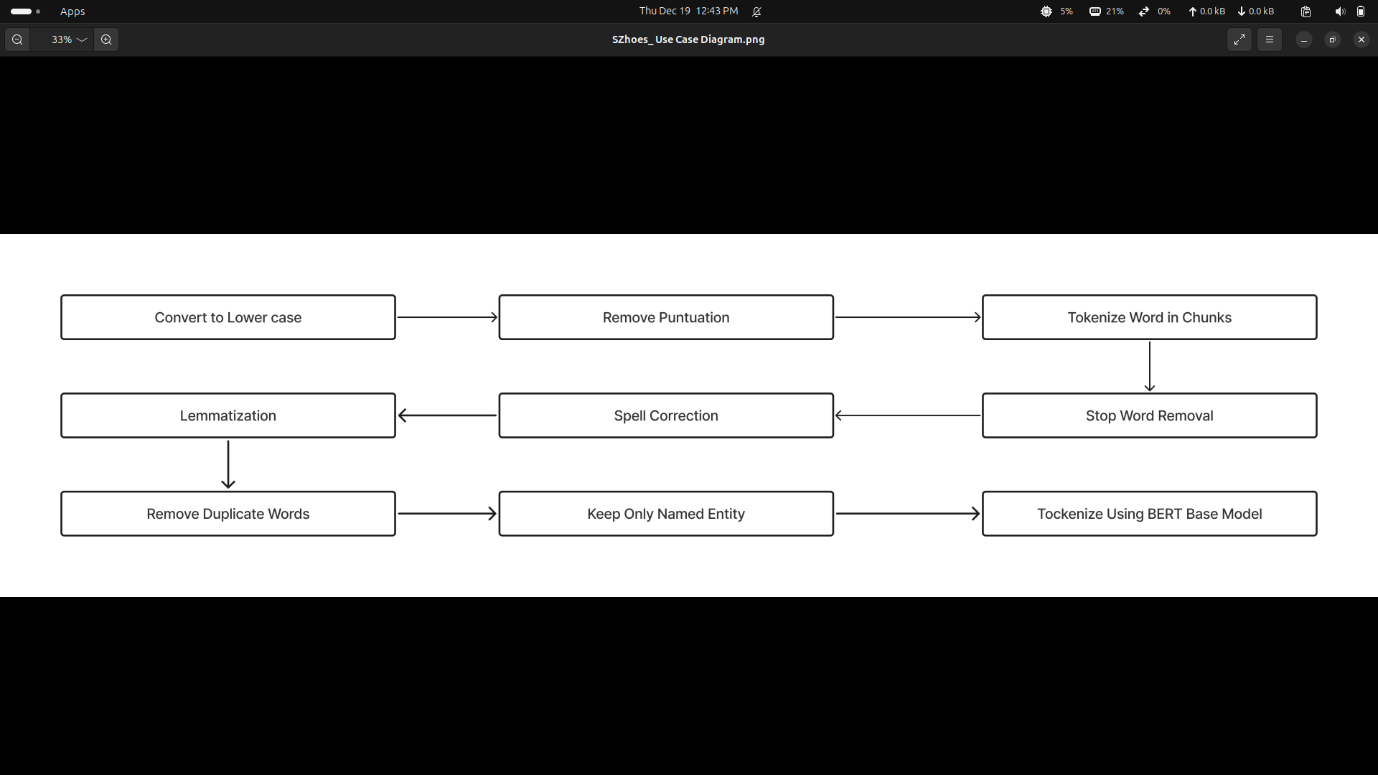
Pre Processing

Slide 8
BERT Model
BERT (Bidirectional Encoder Representations from Transformers) is a powerful pre-trained language model that captures context from both directions of a sentence. The 768-dimensional output vector represents each token in the text, which is used for various NLP tasks, including FAQ retrieval. By transforming user queries into these dense vector representations, BERT can effectively match them to precomputed vectors from an FAQ dataset, even if the query differs in phrasing.
When paired with a vector database like Pinecone. BERT enables efficient and accurate FAQ retrieval through similarity searches using Dot Product algorithm. This setup enhances search relevance, improves user experience, and reduces support overhead, as automated systems can handle a wide range of queries. Additionally, continuous updates to the FAQ database ensure the system adapts to new questions over time.

Slide 9
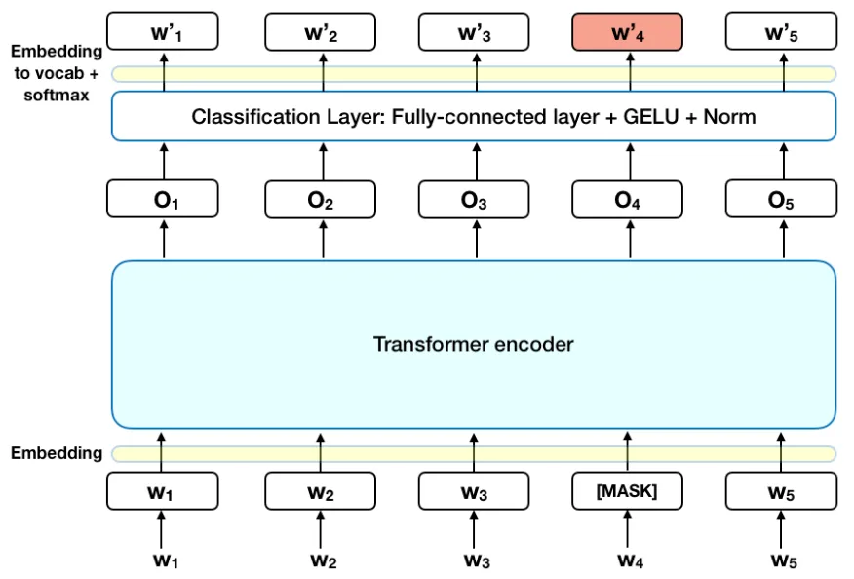
BERT Explaination
https://towardsdatascience.com/bert-explained-state-of-the-art-language-model-for-nlp-f8b21a9b6270?gi=b81f3ce2eb21

Slide 10
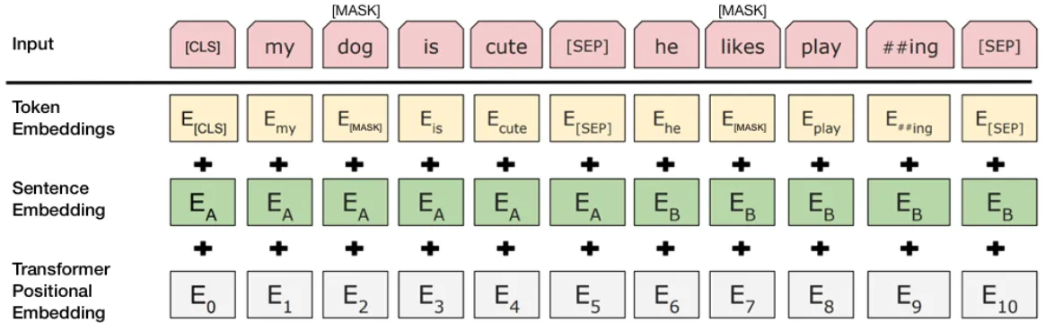
BERT Masking
https://towardsdatascience.com/bert-explained-state-of-the-art-language-model-for-nlp-f8b21a9b6270?gi=b81f3ce2eb21

Slide 11
Technology Used
NLTK
Transformers
Torch
Pinecone
Spacy
Textblob
Flask

Slide 12
SYSTEM ANALYSIS

Slide 13
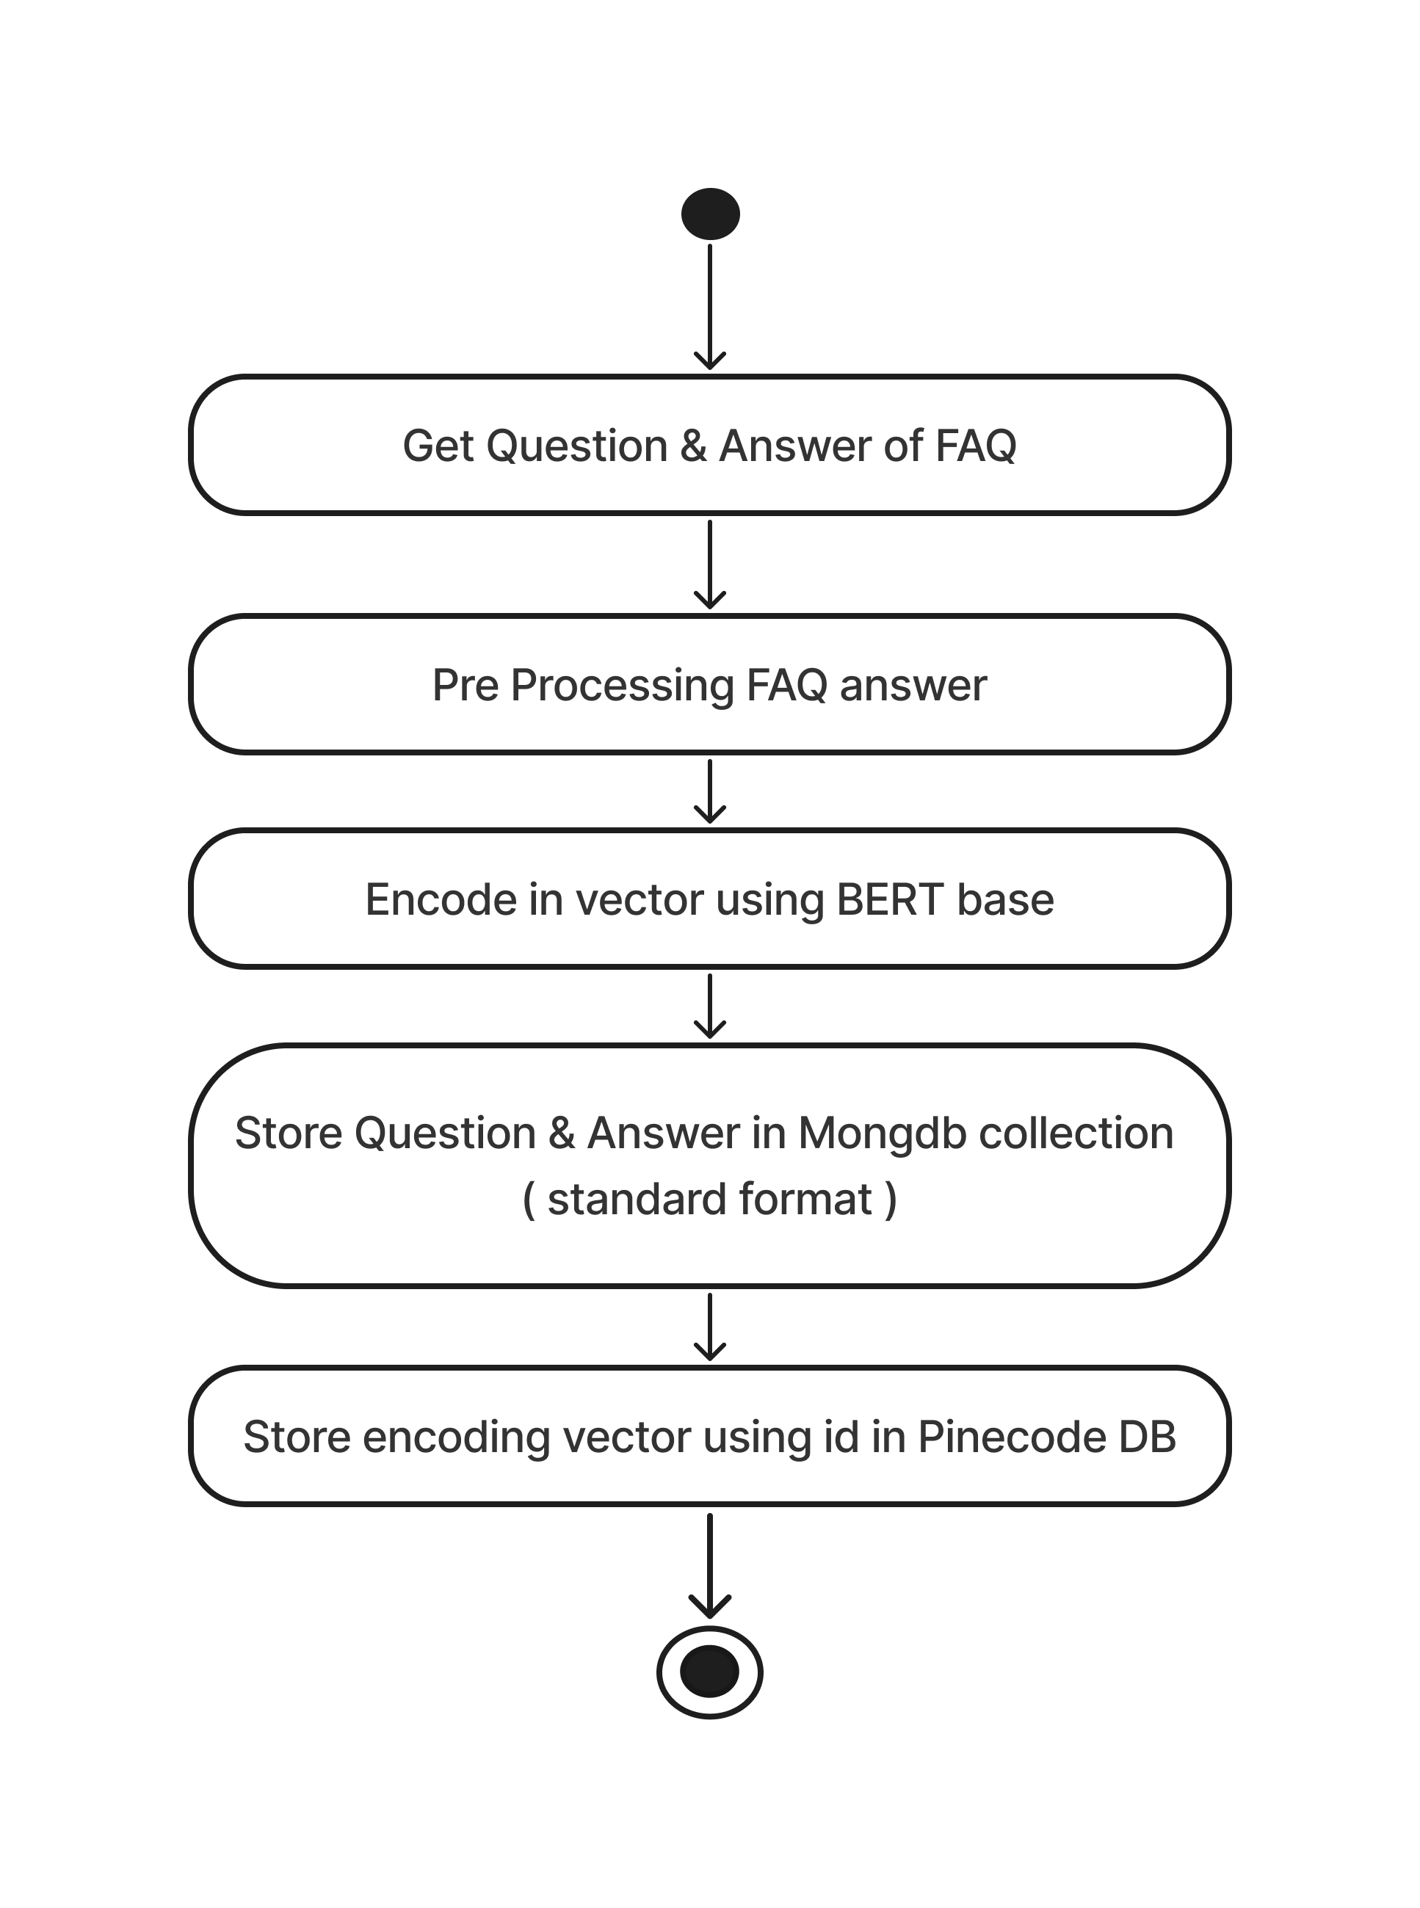
Activity Diagram
Add FAQ

Slide 14
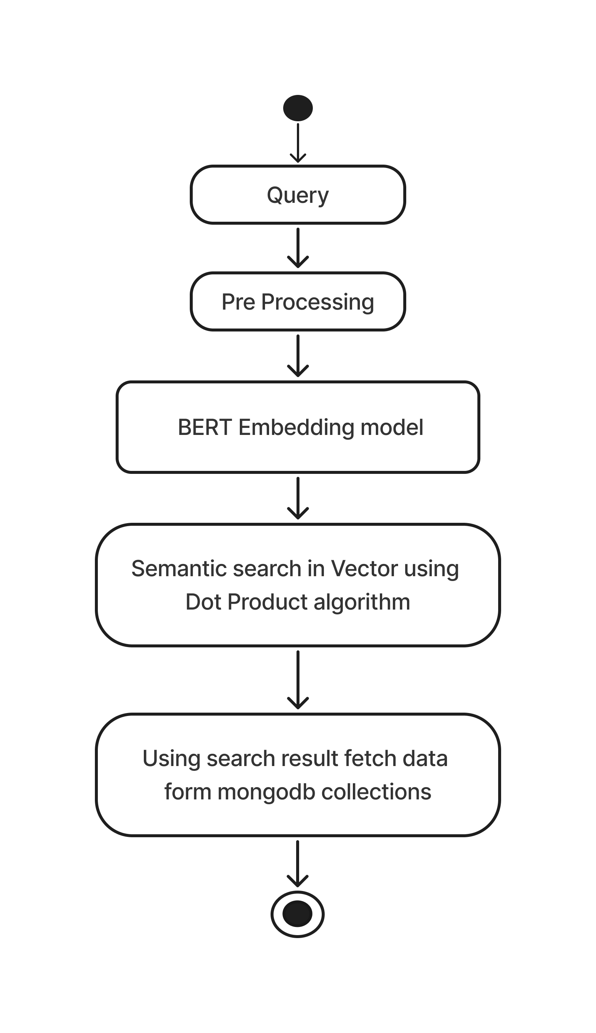
Activity Diagram
Search FAQ

Slide 15
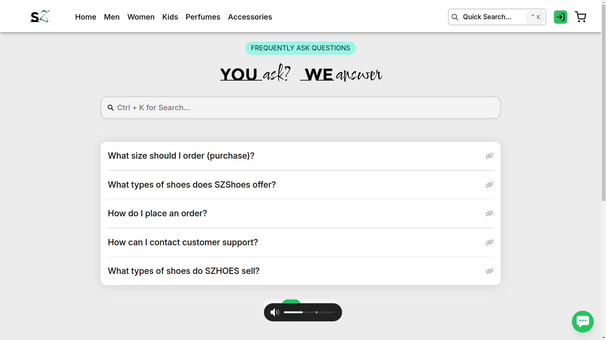
Screenshots

Slide 16
PHASE - 2
Website

Slide 17
Project Description
Creating a user-friendly e-commerce website that sells the footwear and satisfies the customer requirements while streamlining and monitoring the company’s workflow
The SZhoes Shopping Store is an e-commerce website that provides functions like selling the products, managing the whole saler’s and managing the employees by integrate both the e-commerce and the ERP system and enhance the company’s workflow.
It provide the functionality like monitoring and controlling on :
Customer and their Order
Product and their shipping
Manufacturing and Warehouse
Employee and Department

Slide 18
Technology Used
Next.js
Flask
Spring-Boot
JWT
React-email
Zustand
Tailwindcss
Html2Pdf
Progressive web apps ( PWA’s )
SWR ( State-While-Revalidate )

Slide 19
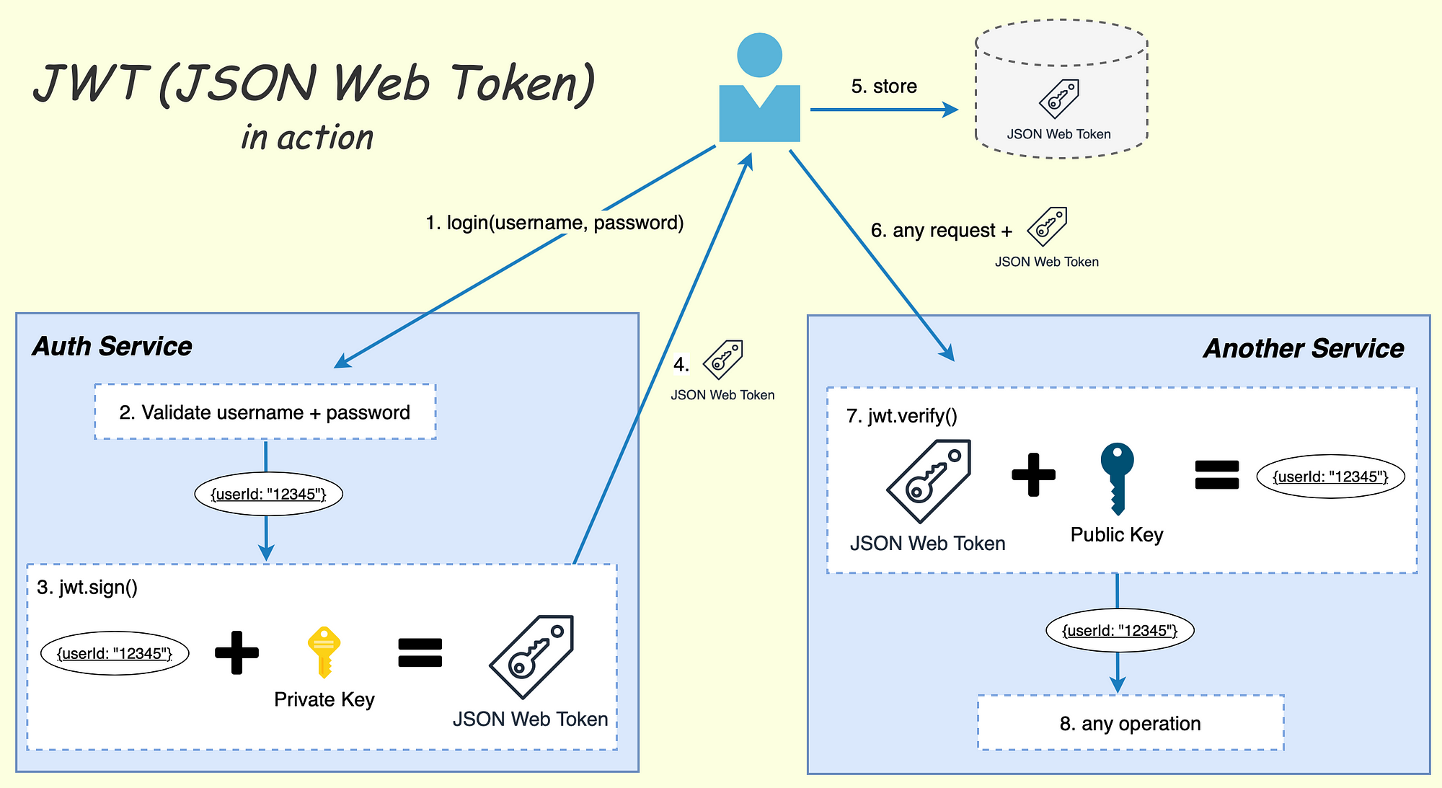
JWT

Slide 20
SYSTEM ANALYSIS

Slide 21
Features of Employee
Manages Customer
Manages Product
Manages Stock of the product
Manages Orders, Return and Payment of the product
Manages Category of the product
Manages Review of the product
Manages Feedback of an e-commerce website
Manages Blog and FAQs of the Customer
Manages Employee , their attendance and their payroll
Manages Department of the SZhoes Company
Provides Chat within the SZhoes Company

Slide 22
Features of Customer
Manages their Profile
Manages their Notification
Manages their Cart and Wishlist
View Previously order Products
View Product
Order the Product
Return the Product
View Blog
Search for the FAQs / Queries
Give Review to the Product
Give Feedback to an e-commerce website

Slide 23
Features of Guest
Login to the SZhoes e-commerce website
Register to the SZhoes e-commerce website
Give Feedback to e-commerce website
View Product and their details
View Blogs
View FAQs
FAQ’s AI assistants

Slide 24
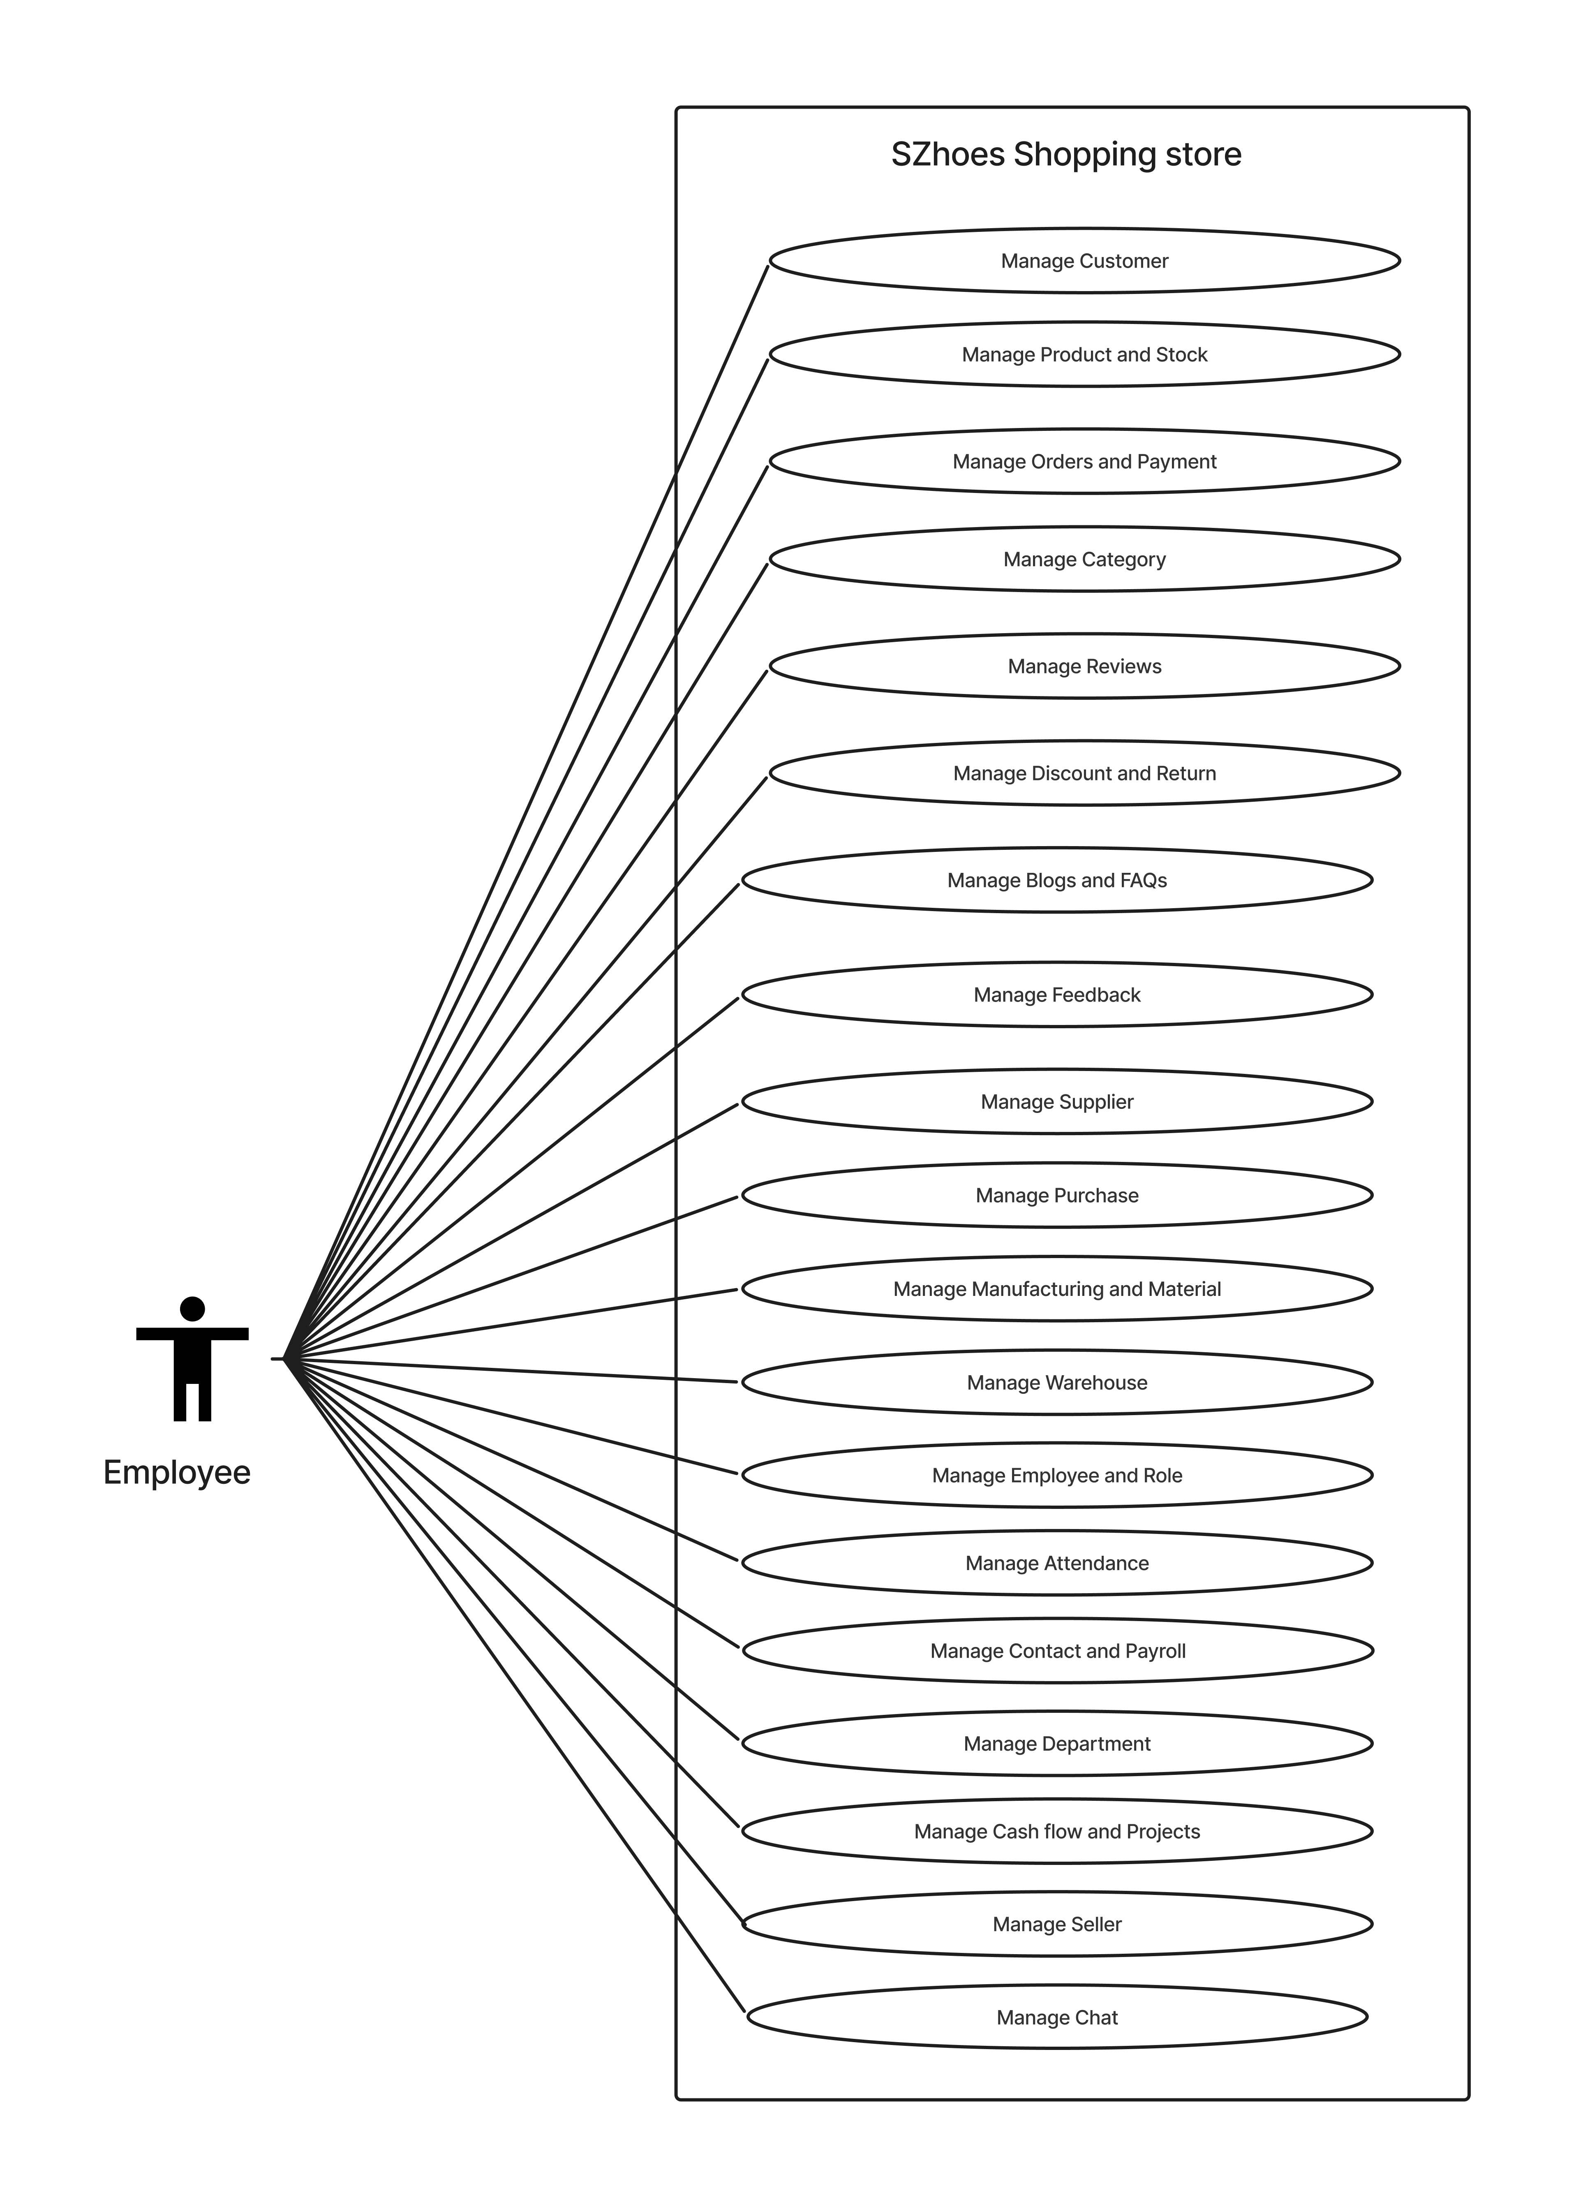
Use Case Diagram of Employee

Slide 25
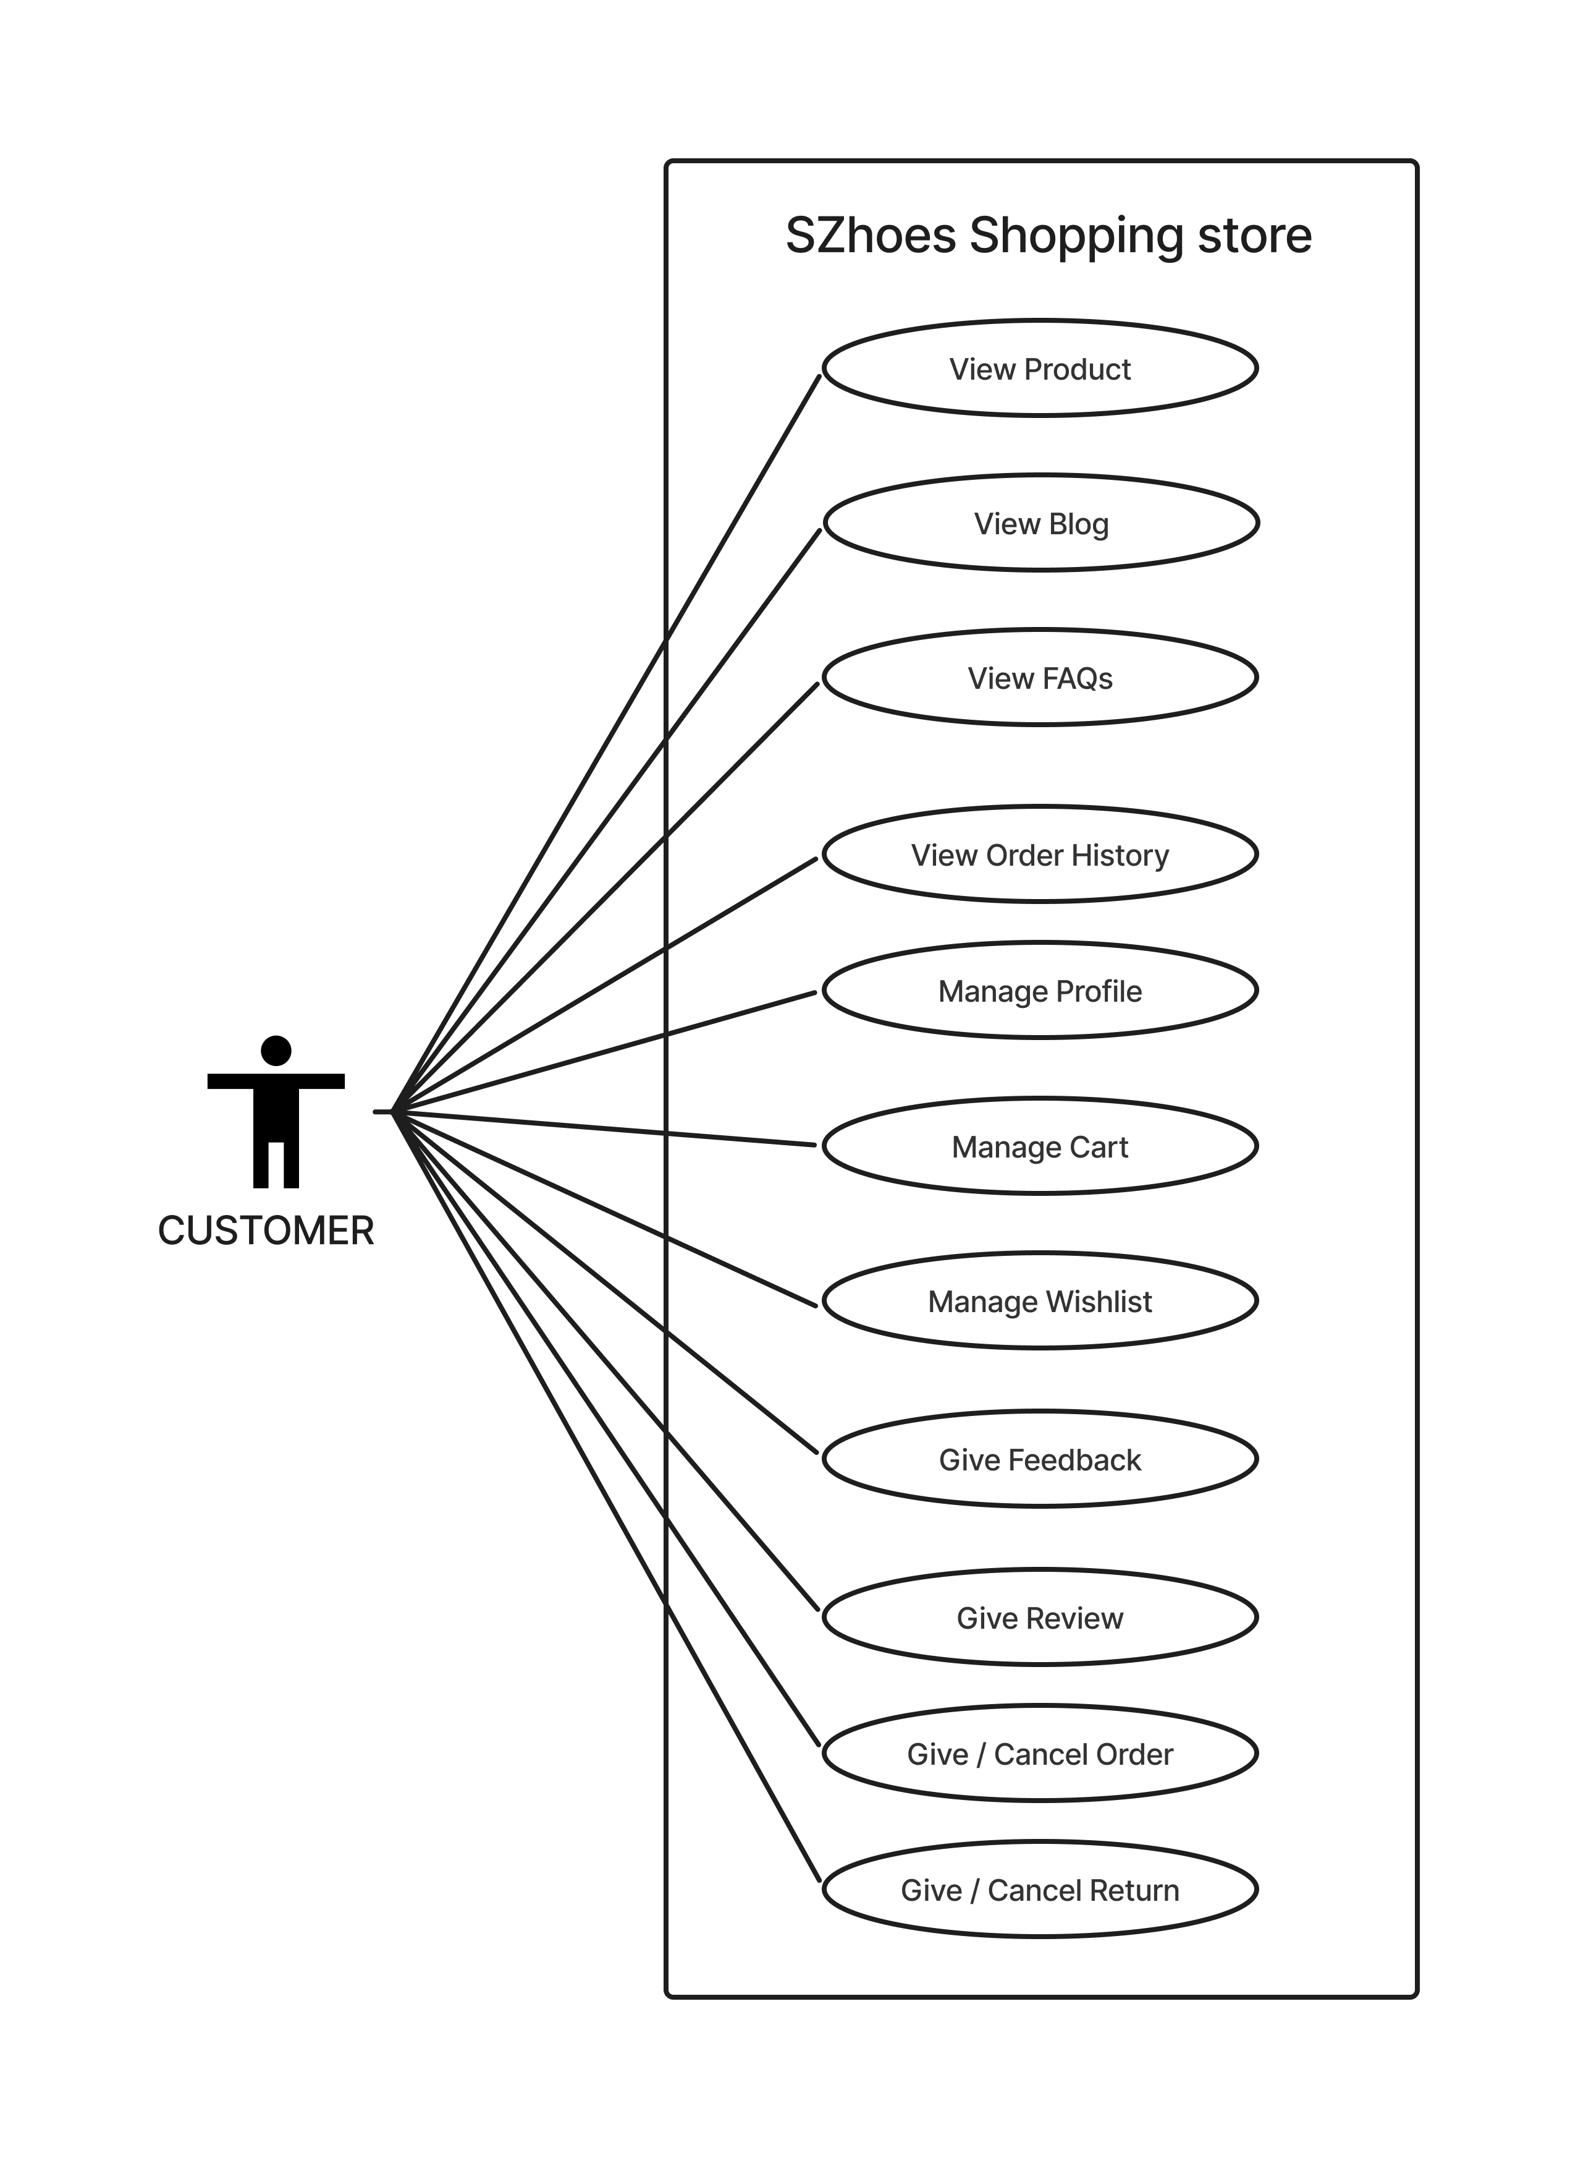
Use Case Diagram of Customer

Slide 26
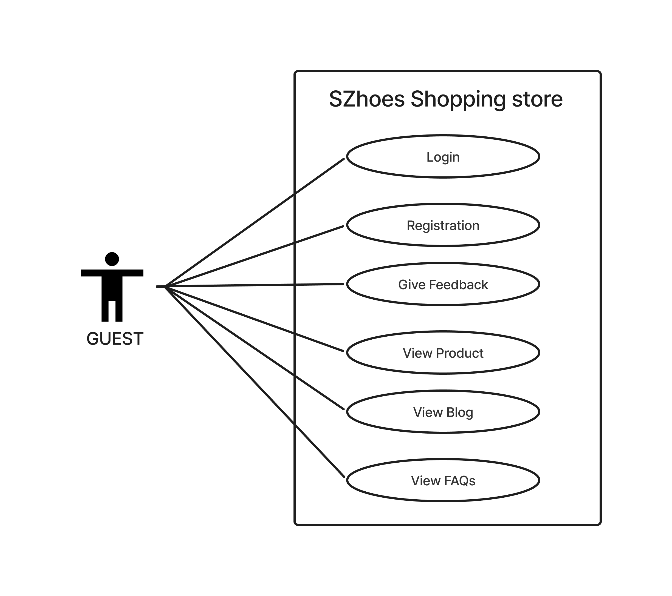
Use Case Diagram of Guests

Slide 27
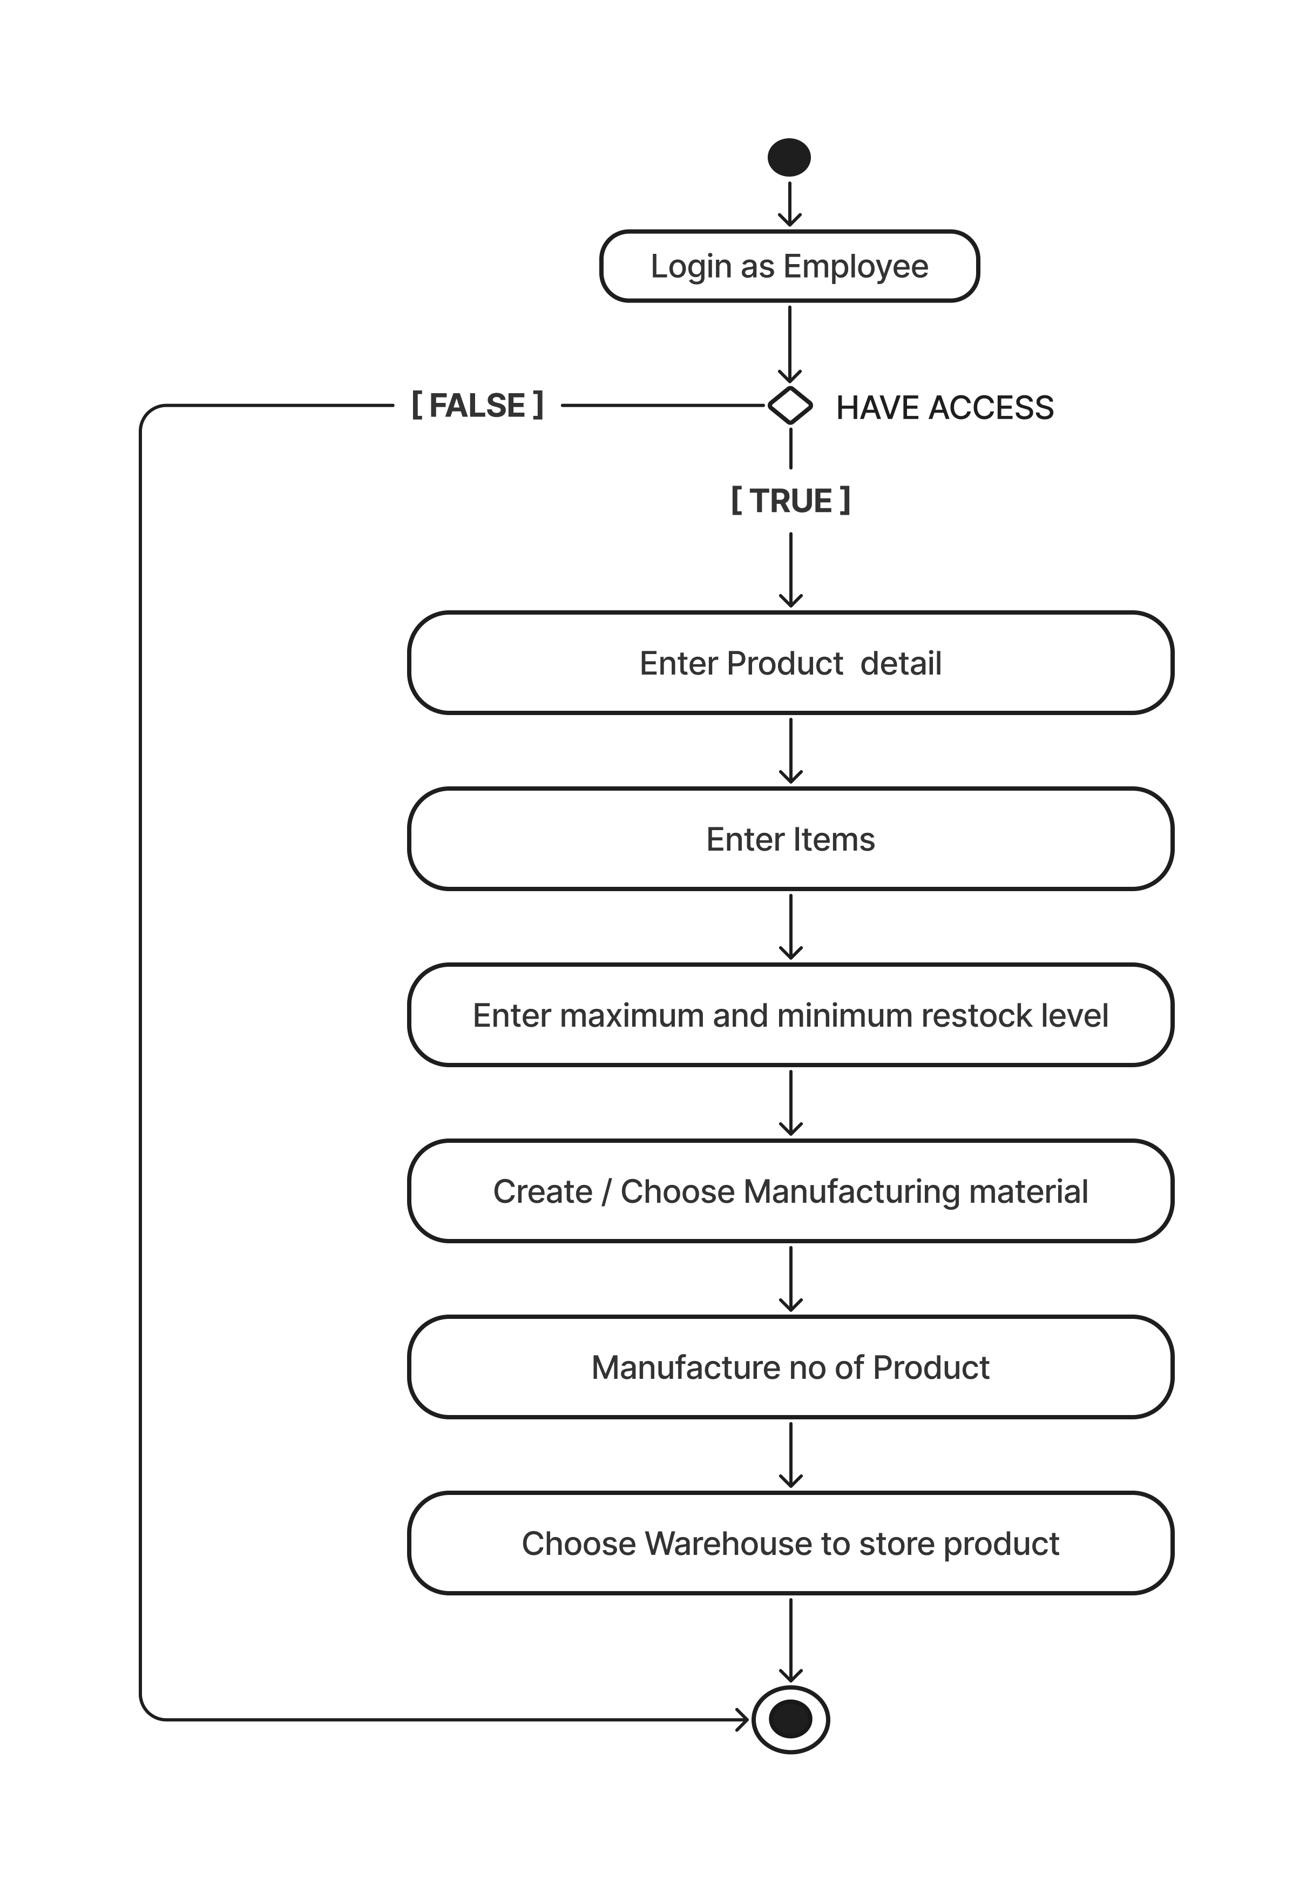
Activity Diagram
Create Product

Slide 28
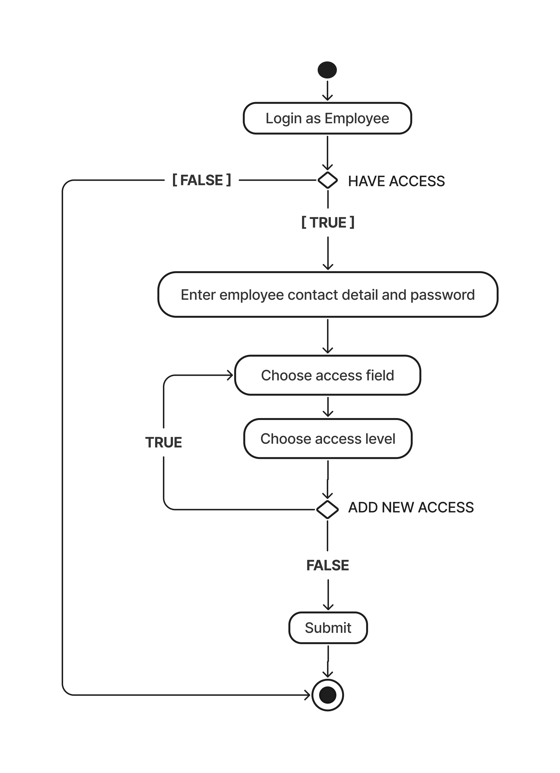
Activity Diagram
Add Employee

Slide 29
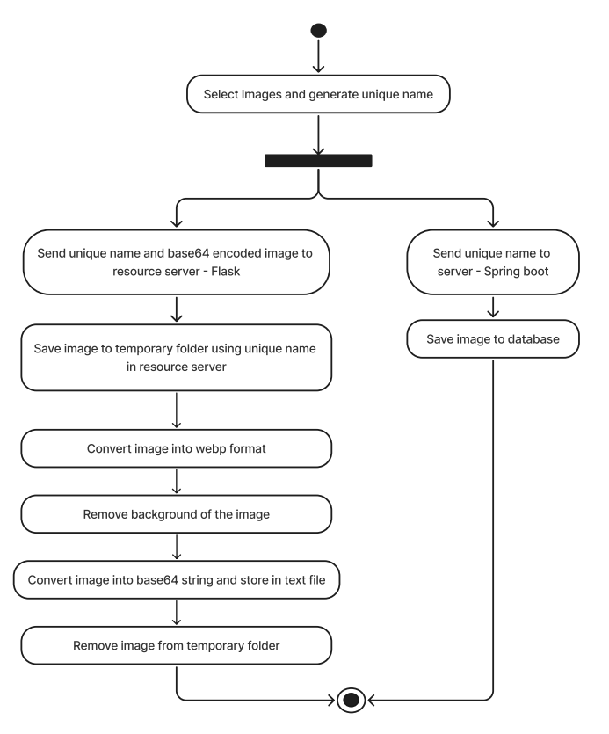
Activity Diagram
Add Images

Slide 30
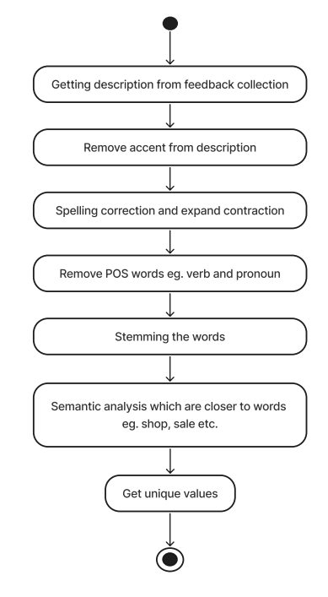
Activity Diagram
Feedback

Slide 31
Class Diagram of Customer (e-com.)

Slide 32
Class Diagram of Employee ( ERP )

Slide 33
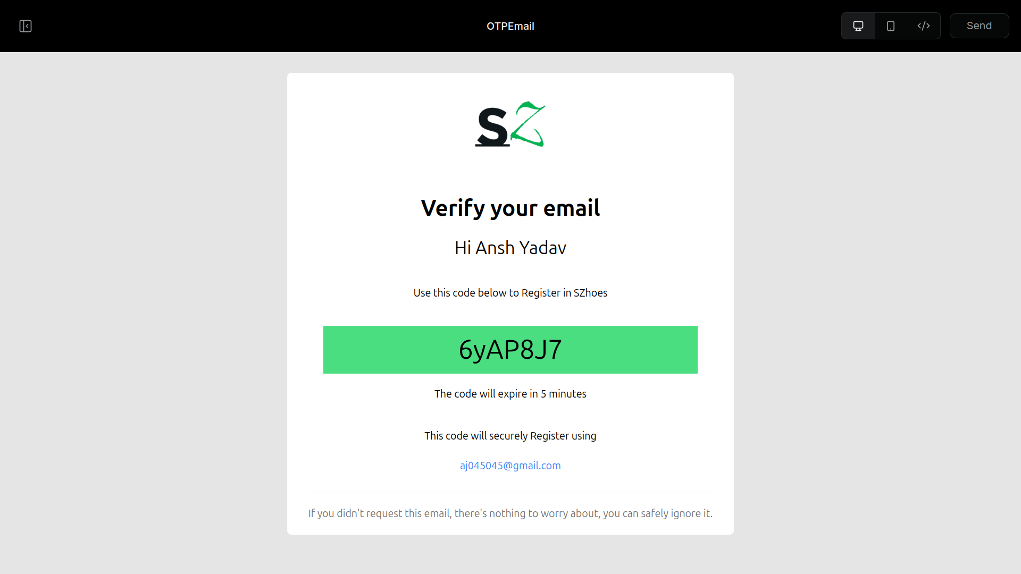
Screenshots

Slide 34
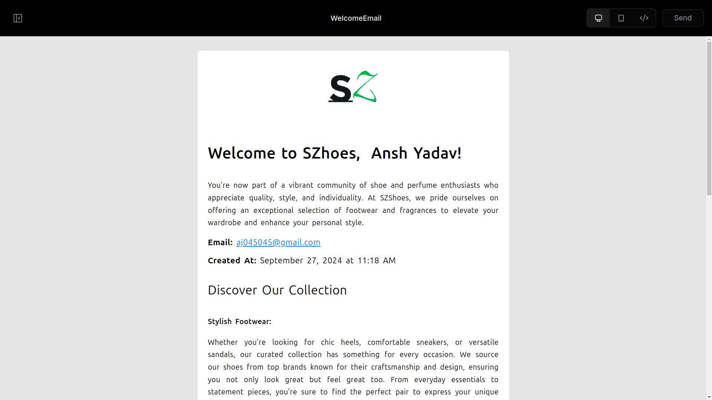
Screenshots

Slide 35
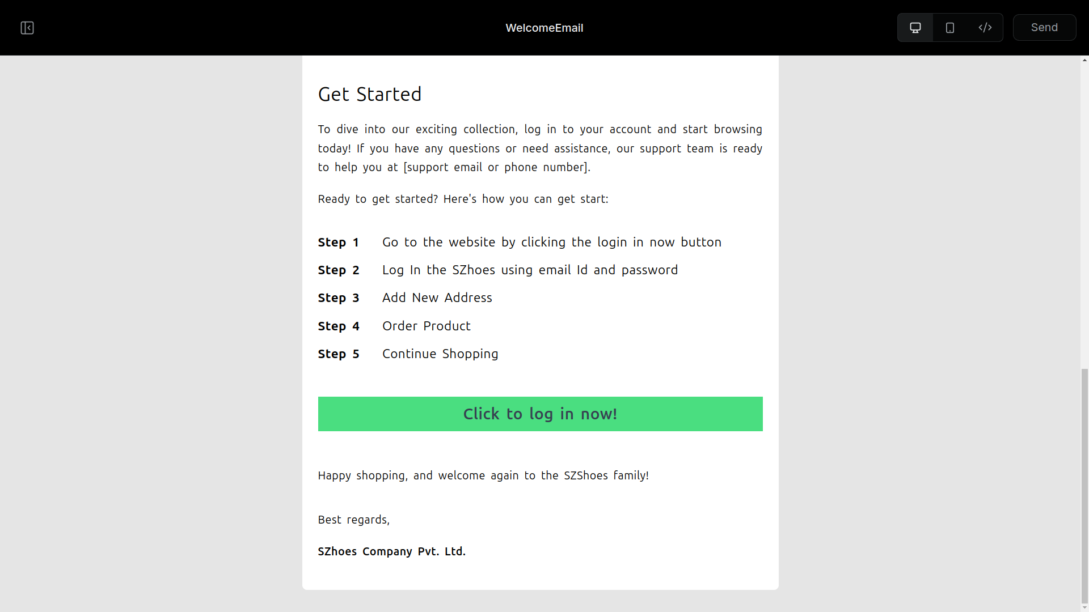
Screenshots

Slide 36
Visualize Report’s
All Customer registration growth chart
All Customer update growth chart
All Customer recently visited growth chart
All Customer last visited growth chart
All Customer notification preference
All Feedback summary
AI Assistant

Slide 37
Future Work
Integrating Cloudinary
Log Creation
Log Analyzer
Product Recommendation
Product Chatbot

Slide 38
Bibliography
Nike ( https://www.nike.com/in/ )
Nextjs ( https://nextjs.org/ )
Flask ( https://flask.palletsprojects.com/en/3.0.x/ )
Spring Boot ( https://spring.io/projects/spring-boot )
BERT Explaination ( https://towardsdatascience.com/bert-explained-state-of-the-art-language-model-for-nlp-f8b21a9b6270?gi=b81f3ce2eb21 )

Slide 39
THANK YOU ☺

